Slide 1
SQL

Slide 2
SQL
The SQL language works with tables called input tables, transforming them into output tables. To perform this transformation, you must compile and execute a query that contains SQL commands.
All SQL commands can be divided into two groups:
DDL (Data Definition Language) commands for defining the structure of a database
DML (Data Management Language) commands for selecting and modifying data tables data.
The SQL language contains only DDL and DML commands. It does not contain any if-then-else or do-while commands.

Slide 3
SQL
The SQL language can be used in real time, the user creates a query in SQL language and runs it, the DBMS (database management system ) executes the query and outputs the result to the user.
SQL commands can also be included in other programs written in different programming languages. In this case, the built-in SQL commands will be used. SQL language queries can be built into many programming languages ​​such as C, C ++, Java, Perl, PHP, VBA, etc.

Slide 4
Data Manipulation (DML)
Following commands are used for data manipulating:
SELECT - extracts data from a database
UPDATE - updates data in a database
DELETE - deletes data from a database
INSERT INTO - inserts new data into a database

Slide 5
Single table data selection
The SELECT statement is used to select data from single or multiple database tables. The data returned is stored in a result table, called the result-set.
Format:
SELECT columns
FROM table name
[WHERE condition]
[GROUP BY columns]
[HAVING group condition]
[ORDER BY columns for sorting];
Square bracket means that the command in a particular statement implementation may not exist.

Slide 6
Single table data selection
SELECT – defines the columns that should appear in result.
FROM – define the output table(s)
WHERE – performs row selection according to the condition
GROUP BY – creates row groups that have the same value in a specific column (column group)
HAVING – selects row groups according to the condition
ORDER BY – performs row sorting

Slide 7
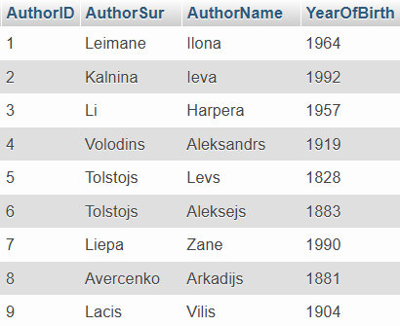
Single table data selection
SELECT *
FROM Authors;

Slide 8
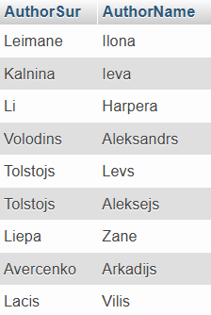
Single table data selection
SELECT AuthorSur, AuthorName
FROM Authors;

Slide 9
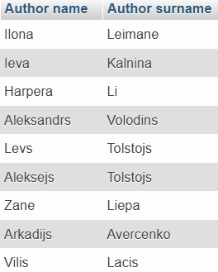
Column aliases
SELECT AuthorName AS `Author name`, AuthorSur AS `Author surname`
FROM Authors;

Slide 10
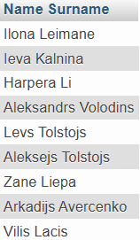
Column aliases
SELECT CONCAT(AuthorName, ' ', AuthorSur) AS ` Name Surname `
FROM Authors;

Slide 11


Ignoring duplicate values
Format:
SELECT DISTINCT columns
FROM table;
SELECT Publisher
FROM Books;
SELECT Distinct Publisher
FROM Books;

Slide 12
Ignoring duplicate values
If multiple columns are included in a SELECT DISTINCT sentence, the same combination of values ​​will not be repeated, even if the columns may contain iterations.
The SELECT DISTINCT statement treats two NULL values ​​as equal values.

Slide 13
Sorting
After executing the query, the DBMS outputs unordered rows. Use the ORDER BY statement to sort the rows.
Format:
SELECT columns
FROM table
ORDER BY columns [ASC|DESC]
where
ASC – ascending order
DESC – descending
The ORDER BY keyword sorts the records in ascending order by default. To sort the records in descending order, use the DESC keyword.

Slide 14
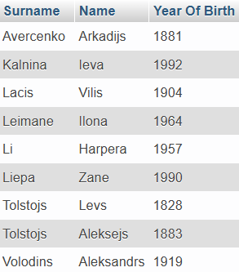
Sorting
SELECT AuthorSur AS Surname, AuthorName AS Name, YearOfBirth AS `Year Of Birth`
FROM Authors
ORDER BY AuthorSur ASC;

Slide 15
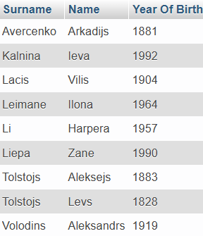
Sorting
Display authors' surnames, names and years of birth. Sort alphabetically by last name. If there are identical surnames - by names.
SELECT AuthorSur AS Surname, AuthorName AS Name, YearOfBirth AS `Year Of Birth`
FROM Authors
ORDER BY AuthorSur, AuthorName;

Slide 16
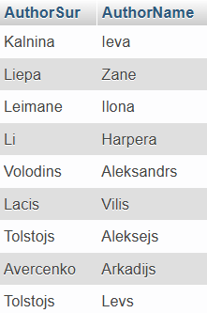
Sorting
This example shows that the column name you sort by may not be in the SELECT statement.
SELECT AuthorSur, AuthorName
FROM Authors
ORDER BY YearOfBirth DESC;

Slide 17
Row selection using condition
The WHERE clause is used to filter records.
The WHERE clause is used to extract only those records that fulfill a specified condition.
Format:
SELECT columns
FROM table
WHERE column OPERATOR value
[ORDER BY columns];

Slide 18
Row selection using condition
The following operators can be used in the WHERE clause:
You can compare:
text
numbers
same format date and time values ​
Operator | Description
= | Equal
> | Greater than
< | Less than
>= | Greater than or equal
<= | Less than or equal
<> | Not equal. Note: In some versions of SQL this operator may be written as !=
BETWEEN | Between a certain range
LIKE | Search for a pattern
IN | To specify multiple possible values for a column
IS [NOT] NULL | Test for NULL Values

Slide 19

Row selection using condition
Example: Display the name and year of birth of the author with the surname 'Leimane'.
SELECT AuthorSur AS Surname, AuthorName AS Name, YearOfBirth AS `Author Year Of Birth`
FROM Authors
WHERE AuthorSur = 'Leimane';

Slide 20

Row selection using condition
Display surnames and names for authors born after 1990.
SELECT AuthorSur AS Surname, AuthorName AS Name
FROM Authors
WHERE YearOfBirth > 1990;

Slide 21

Row selection using condition
Readers received the library service at 12:30.
You can combine conditions with AND and OR.
SELECT ReaderID AS ` Reader ID number `
FROM Journal
WHERE TIME(SStartTime) = '12:30:00' OR TIME(SFinishTime) = '12:30:00';

Slide 22

Row selection using condition
Readers received the library service between 12:00 and 13:00.
SELECT ReaderID AS ` Reader ID number `
FROM Journal
WHERE TIME(SStartTime) >= '12:00:00' AND TIME(SFinishTime) <= '13:00:00';

Slide 23
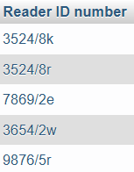
Row selection using condition
Readers received the library service between 12:00 and 13:00. (another example)
SELECT ReaderID AS `Reader ID number`
FROM Journal
WHERE (extract(hour from SStartTime) >= 12)
AND (extract(hour from SStartTime) <= 13)

Slide 24
Row selection using condition
LIKE operator
LIKE operator is used when exact values ​​are unknown or partially known.
LIKE operator only works with text values
a template using a metasymbol is used with the LIKE operator.
Template - a set of symbols in quotation marks the value must match with
Metasymbols: % - any number of characters, _ - any single character
You can use the NOT LIKE operator
You can use complex conditions by using OR and AND
If the template has no metasymbols, LIKE is equal to the comparison operator =, but NOT LIKE is equal to <>

Slide 25
Row selection using condition
LIKE operator
Here are some examples showing different LIKE operators with '%' and '_' wildcards:
Template | Possible values
‘R%’ | Rīga, Rundāle, Rembrants
‘%s’ | Dēls, Name, debess
‘Qua___’ | Quatro
‘%re_’ | Tree, area, red, Blood red

Slide 26

Row selection using condition
Example: Display surnames and names for authors whose last names begin with the letter A and whose last names ends with -s or -is. Sort the result by author names in alphabetical order.
SELECT AuthorSur AS Surname, AuthorName AS Name
FROM Authors
WHERE (AuthorSur LIKE 'A%')
AND ( (AuthorName LIKE '%s') OR (AuthorName LIKE '%is'))
ORDER BY AuthorSur;

Slide 27
Row selection using condition
BETWEEN operator
This operator verifies that the value of a column is within a certain range.
Format:
WHERE column [NOT] BETWEEN value1 AND value2;

Slide 28
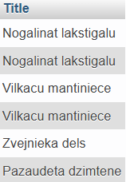
Row selection using condition
Example: display books titles for books that have from 1 to 5 copies.
SELECT Title
FROM Books
WHERE NumOfCopies BETWEEN 1 AND 5;

Slide 29
Row selection using condition
IN operator
IN operator allows you to specify multiple values in a WHERE clause.
IN operator is a shorthand for multiple OR conditions.
Format:
SELECT columns
FROM table
WHERE column [NOT] IN (value1, ..., value n)

Slide 30
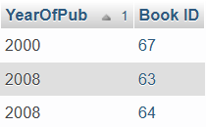
Row selection using condition
Example: display the books that were published during the long years of the 21st century.
SELECT YearOfPub, BookID AS `Book ID`
FROM Title_page
WHERE YearOfPub IN (2000, 2002, 2004, 2008)
ORDER BY YearOfPub;

Slide 31
Row selection using condition
NOT NULL operator
The LIKE, BETWEEN, and IN operators do not see a NULL value. Use IS NULL or IS NOT NULL operators to find it. These operators can work with any type of value. With AND and OR you can construct complex conditions.
Format:
WHERE column IS [NOT] NULL

Slide 32

Row selection using condition
Example: Display comments about authors
SELECT Comment, AuthorID AS `about author`
FROM Comments
WHERE Comment IS NOT NULL;

Slide 33
Practice
Display authors who were born in the 19th century.
Display books whose Title begins with the letter 'V'.
Display books whose Title begins with the letter 'V', by leaving only book titles and removing duplicates.
Display the reader's last name and address by combining the address (street, house, flat) in one field.
Task 4 + sort by last name.

Slide 34
Practice
Display the Reader ID number and Book Return Date from the Taken books, sort by Date in descending order.
Display all Journal service operations that took place in December 2011, display only Reader ID and Date fields, sort by Date.
By using "IN", display all Journal services that took place in the autumn.
Display the Name and surname of the reader (with AS) who does not have a phone number.

Slide 35
Answers
1a.
SELECT *
FROM Authors
WHERE (YearOfBirth>=1800) AND (YearOfBirth<=1900);
1b.
SELECT *
FROM Authors
WHERE YearOfBirth BETWEEN 1800 AND 1900;
2.
SELECT *
FROM Books
WHERE Title LIKE 'V%';
3.
SELECT DISTINCT Title
FROM Books
WHERE Title LIKE 'V%';
4.
SELECT ReaderSur, CONCAT(Street, ' ', House, ' ', Flat) AS Address
FROM Readers;
// CONCAT_WS
SELECT ReaderSur, CONCAT_WS(' ', Street, House, Flat) AS Address
FROM Readers;

Slide 36
Answers
5.
SELECT ReaderSur, CONCAT(Street, ' ', House, ' ', Flat) AS Address
FROM Readers
ORDER BY ReaderSur;
6.
SELECT ReaderID, ReturnDate
FROM Books_taken
ORDER BY ReturnDate DESC;
7.
SELECT ReaderID, SDate
FROM Journal
WHERE YEAR(SDate) = 2011 AND MONTH(SDate) = 12
ORDER BY SDate;
8.
SELECT *
FROM Journal
WHERE MONTH(SDate) IN (9,10,11);
9.
SELECT ReaderSur AS Surname, ReaderName AS Name
FROM Readers
WHERE PhoneNum IS NOT NULL;

